Slide 1
WORMS 101
HOW TO START A WORM FARM

Slide 2
Why worms?
Goal: zero waste
Free healthy compost
Easy!
Inexpen$ive

Slide 3
How do I create a worm farm?
Two nesting 18-gallon plastic tubs (need one lid)
Bricks or something to hold inner tub up to allow drainage
Something to drill or poke aeration holes in tub (not lid)
Bedding - damp
Mix #1: Torn paper + egg cartons + cardboard (remove tape, staples)
Mix #2: Coir (coconut husk) + Leaf mulch + Old spent soil
1 piece of damp cardboard cut to fit flat inside bin
Food scraps, egg shells
Red Wigglers!

Slide 4
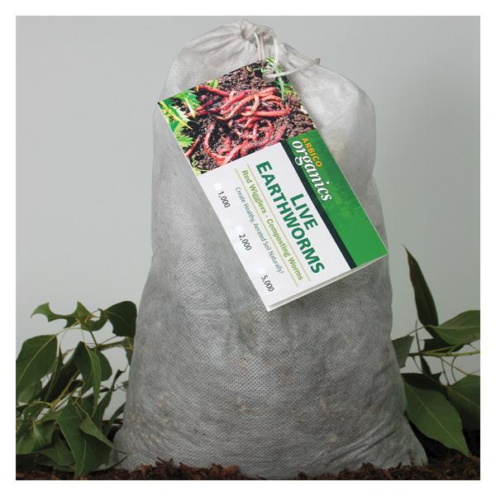
Red Wigglers

Slide 5
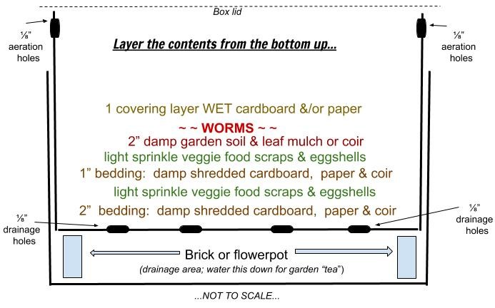

Slide 6
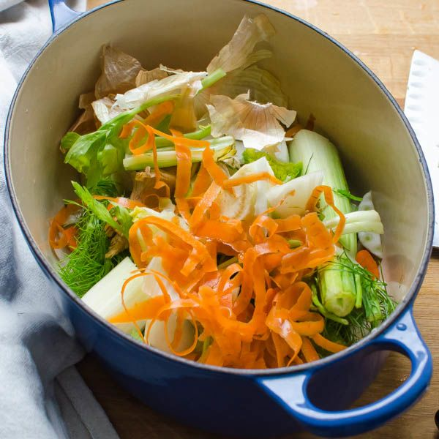
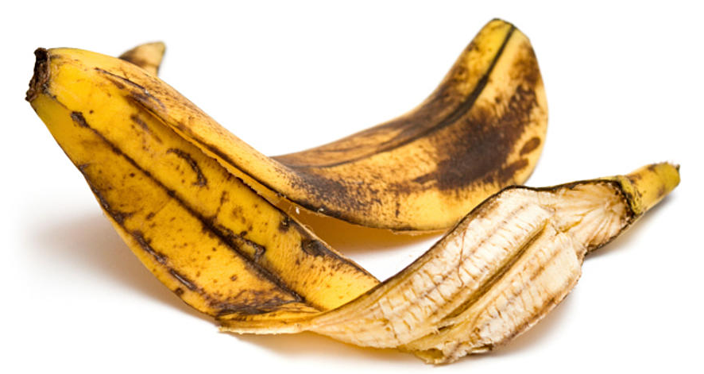
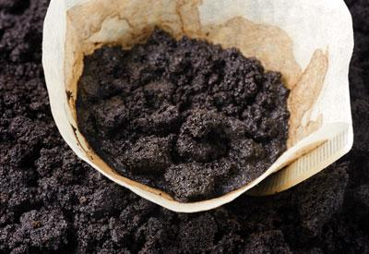
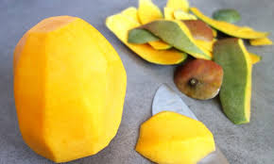
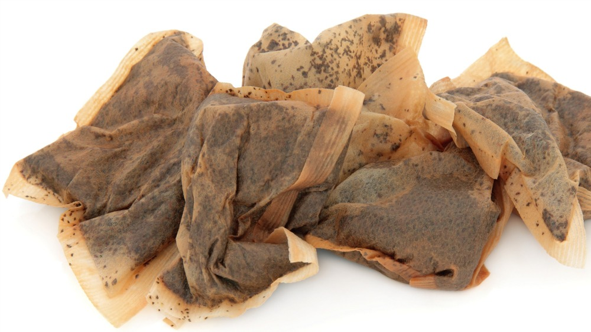
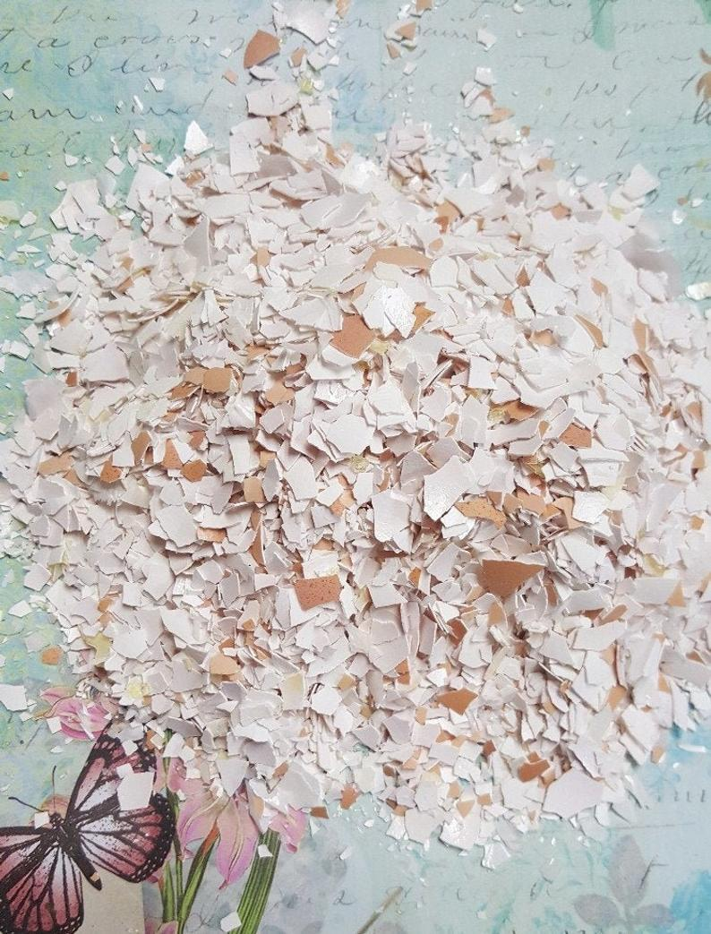
What food scraps do I feed my worms?

Slide 7
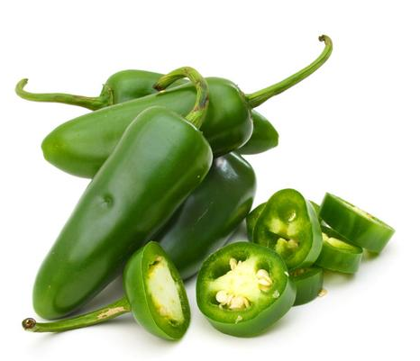
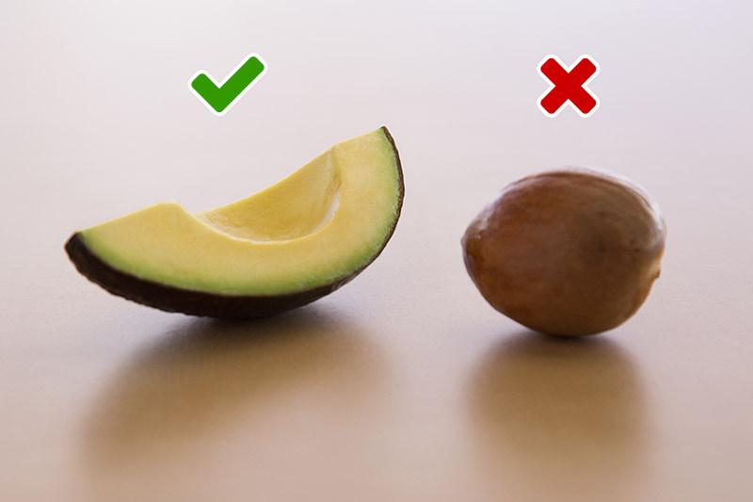
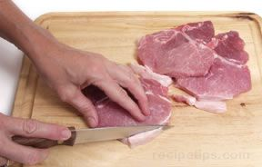
Foods to avoid

Slide 8
How often do I feed them?
After first setting up the bin, don’t feed for about a week. They need to settle in.
After that, bury up to a cup of small scraps a day. If they’re not eating everything, skip a day or two.
Move the scraps around from day to day.
If you’re going to gone a few days, leave larger scraps.
They will eat all their bedding, it’s okay!

Slide 9
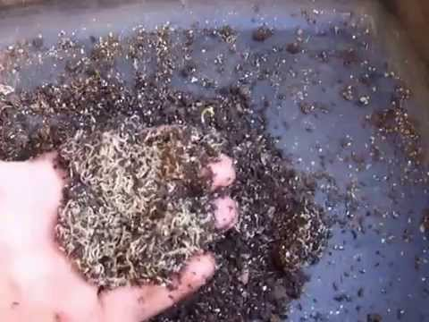
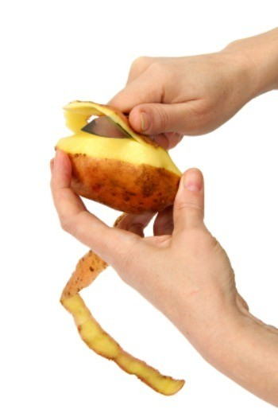
A word about starch...
PS: The cure for potworms is to add eggshells.

Slide 10
Okay, I’ve got worm castings!
As you add more food, the worms move up, castings (compost) go down.
Gently move worms aside, scoop some castings out of the bottom.
Mix into your soil, or top dress.
Worm castings will not burn plants. They are rich in water-soluable nutrients, and contain more than 50% more humus than normal topsoil. They are packed with minerals essential for plant growth: concentrated nitrates, phosphorus, magnesium, potassium & calcium!

Slide 11
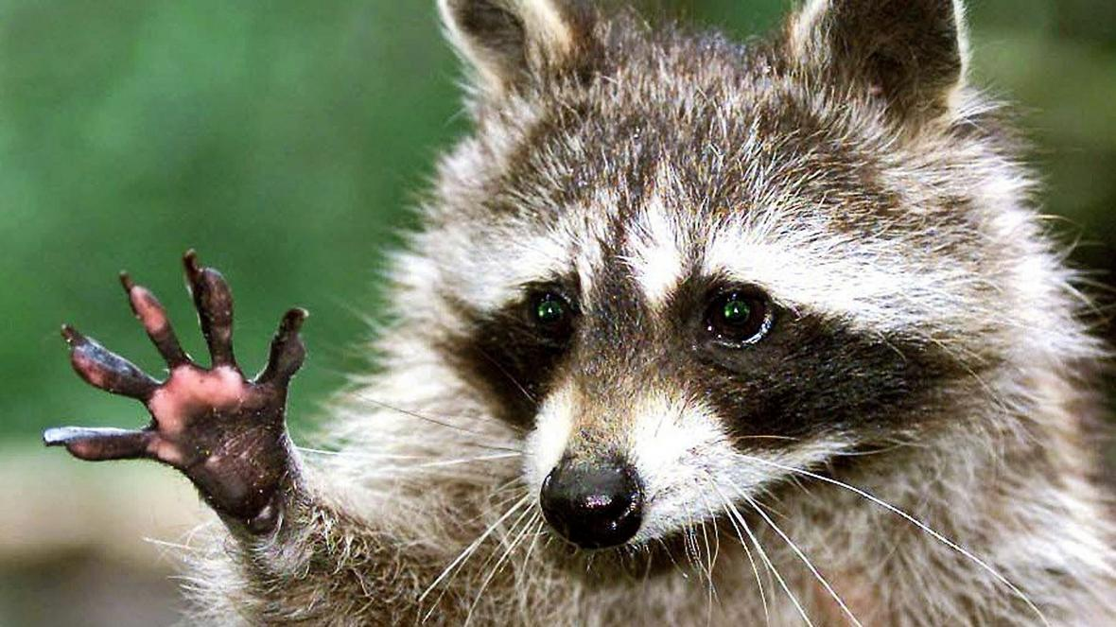
Final thoughts (almost)...

Slide 12
Resources
CityFarmers.com - worms about $18 a bag. Check website to make sure they’re in stock!
UncleJimsWormFarm.com - everything online
San Diego Climate Action Plan & Zero Waste Initiative (ask for links)
Solano Center “Rotline” - 760-436-7986, x700, or email compost@solanacenter.org

Slide 13
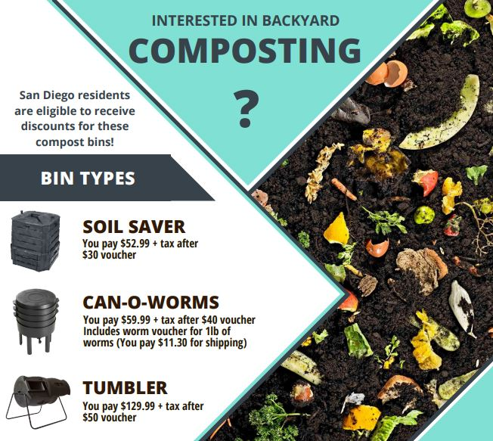
City of SD Environmental Services
www.sandiego.gov/environmental-services/recycling/residential/composting

Slide 14
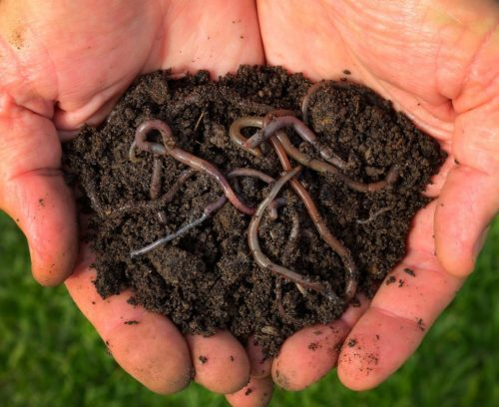
Questions?
laru.kim@gmail.com

